Slide 1
Faster Matrix Completion Using Randomized SVD
Jingyi Feng, Hangtian Zhu

Slide 2
Problem Statement
Current SVT(singular value threshold) and IALM(inexact augmented Lagrange multiplier) algorithms for matrix completion are computationally expensive for handling large dataset.
Randomized matrix computation involves fewer flops and efficient for large datasets.
Innovation: two fast rSVD for sparse matrix and subspace recycling methods for acceleration. 6x faster
Contribute to image inpainting.

Slide 3
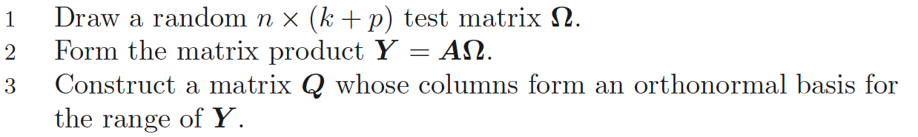
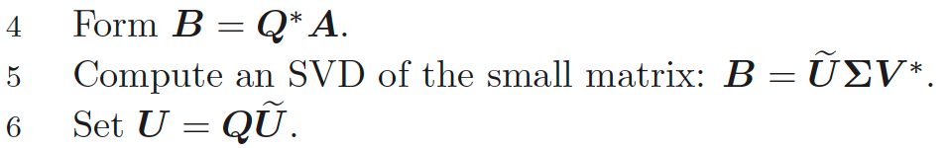
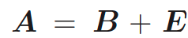
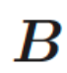
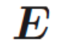
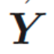
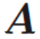
Randomized SVD
Low-rank k approximation with p oversampling parameters
Stage A
Stage B
Intuition: where is rank-k matrix and is perturbation.
Use to approximate by random matrix theory, and oversampling to prevent converging to entire range of

Slide 4
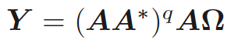
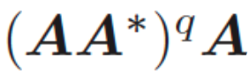
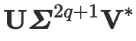
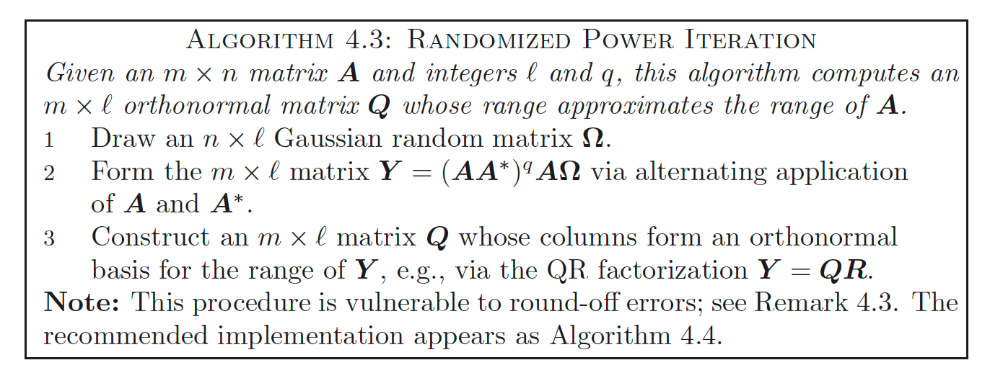
Randomized SVD
Concern: what if singular values decay slow? Random matrix may not well capture the desired subspace.
Use instead, since = . The left singular vectors are not changed, hence basis are not changed. However, powering singular values can accelerate decaying.

Slide 5
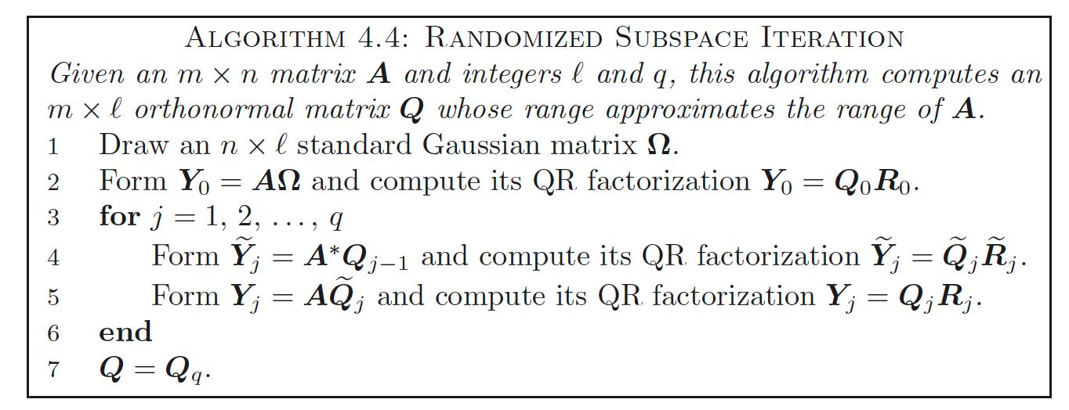
Randomized SVD
Unfortunately, when Algorithm 4.3 is executed in floating-point arithmetic, rounding errors will extinguish all information pertaining to singular modes associated with singular values that are small compared with A [1]
Add orthogonalization when apply each A
[1] N. Halko, P. G. Martinsson, and J. A. Tropp, “Finding structure
with randomness: Probabilistic algorithms for constructing approximate
matrix decompositions,” SIAM Review, vol. 53, no. 2, pp. 217–288, 2011.

Slide 6
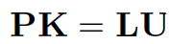
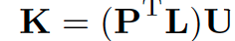
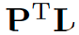
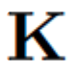
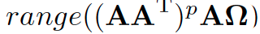
Preliminary / Newly proposed ideas
In the power iteration, orthonormalization after each matrix multiplication is not necessary.
Power iteration is accelerated by replacing the QR factorization with LU factorization.
Pivoted LU factorization gives . Therefore, has same column space as , and hence it produces basis for
eigSVD is proposed, and efficient when matrix A(m x n) m>>n.

Slide 7
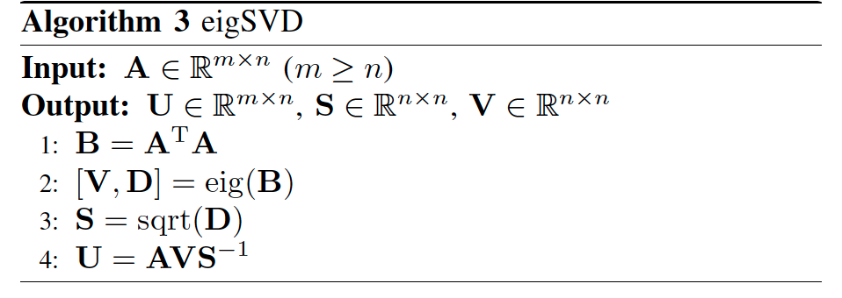
eigSVD

Slide 8
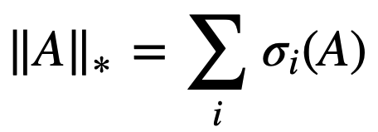
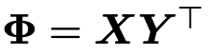
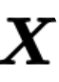
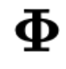
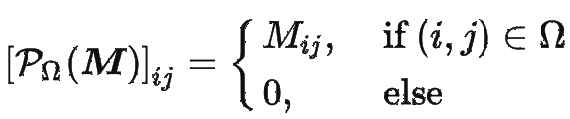
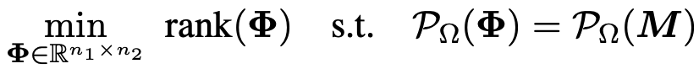
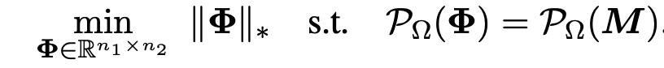
Matrix Completion
Nuclear norm: Sum of singular values:
Low-rank matrix completion can be treated as low-rank approximation:
Problem: where
Rank-minimization is NP-Hard.
Consider rank = number of non-zero singular values.
Replace rank by nuclear norm for convex relaxation.
Problem:

Slide 9
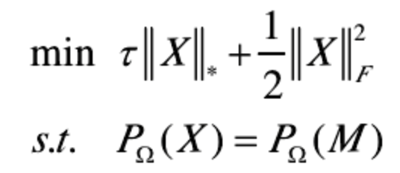
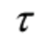
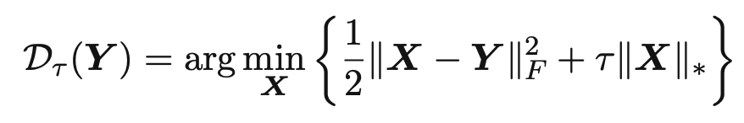
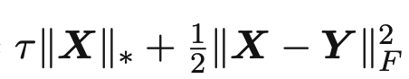
Matrix Completion via Singular Value Threshold
From to
equation holds when is large.
Soft-thresholding operator
Can verify , and is convex, it has global minimizer.

Slide 10
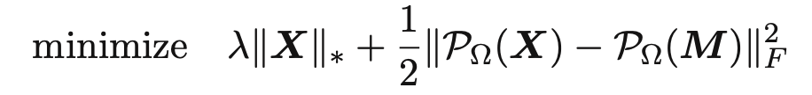
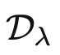
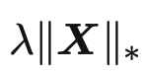
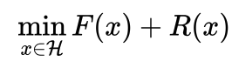
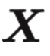
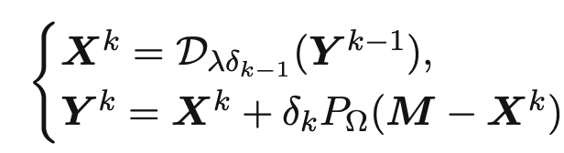
Matrix Completion via Singular Value Threshold
Problem equals:
is the proximity operator of
Problem in the format of convex optimization problem
Proximal gradient (forward backward splitting) method to find

Slide 11
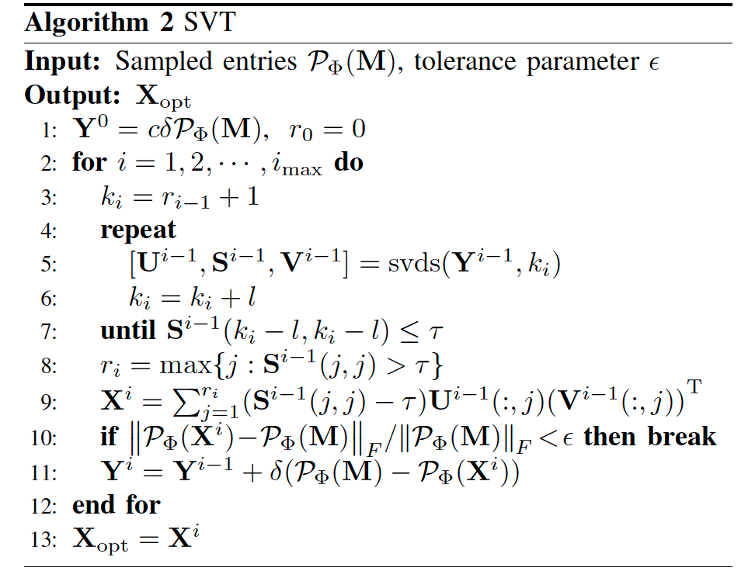
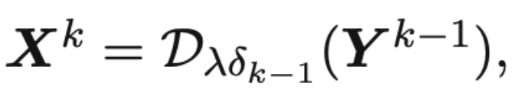
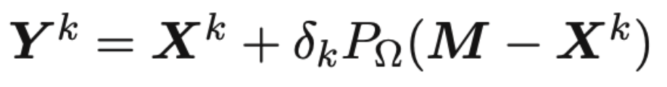
SVT Algorithm
1-9
10-11

Slide 12
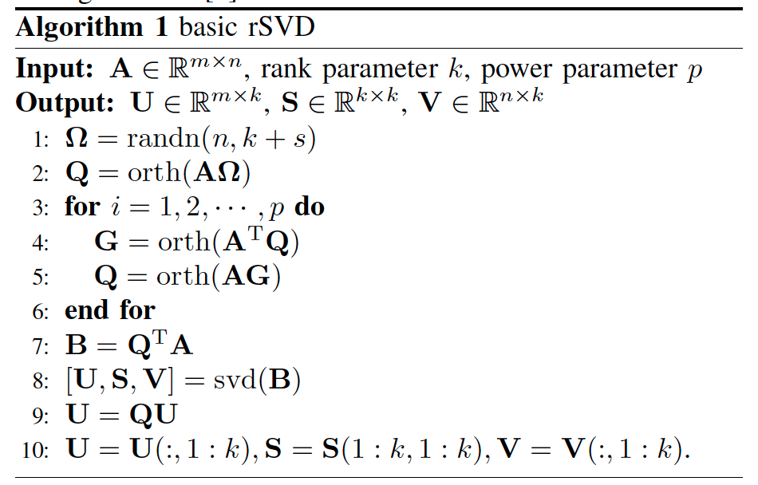
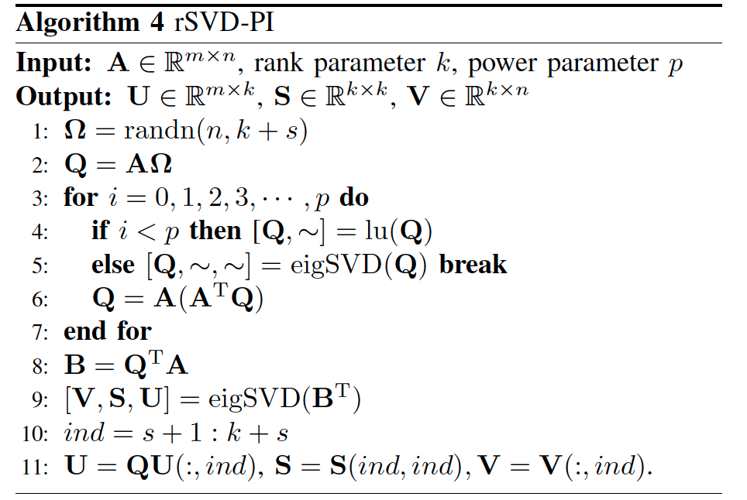
rSVD-PI(Power Iteration)
Mathematically equivalent except
Using LU instead of QR in step2
Not orthogonal basis when multiplying matrix in step 4, 5
Using left eigenvector instead of Q matrix in QR as orthogonal basis in step 5
Using eigen decomposition method to calculate SVD

Slide 13
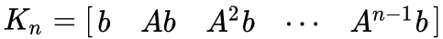
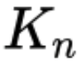
Krylov subspace
Very best k rank approximation to A lying in the span of
Applying Gram-Schmidt process to the power sequence (Arnoldi's algorithm), it delivers a sequence of orthogonal basis of .
We use the orthogonal basis in rSVD.

Slide 14
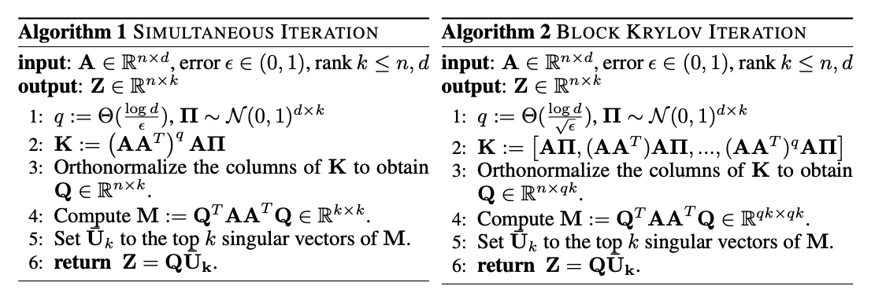
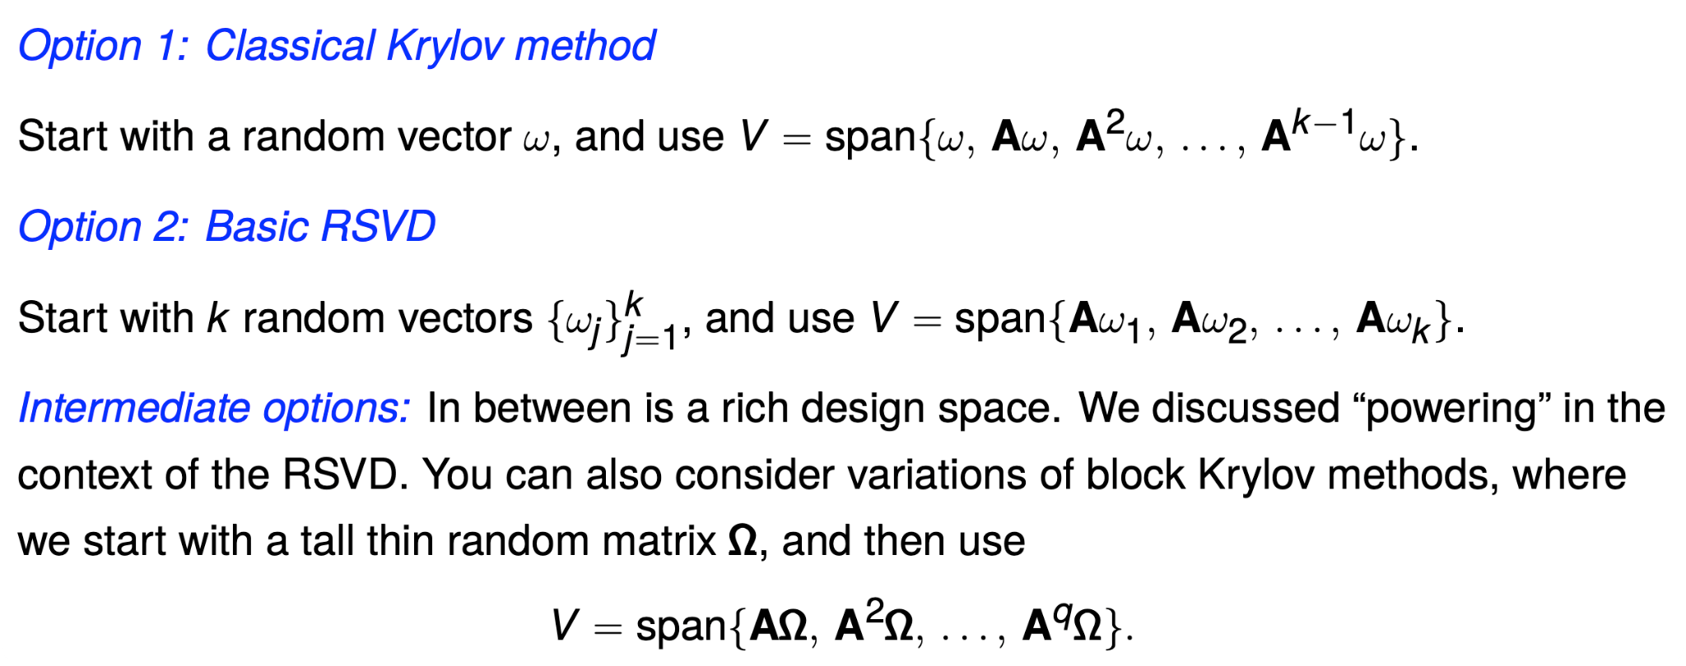
rSVD-BKI(block Krylov-subspace iteration)

Slide 15
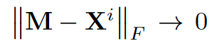
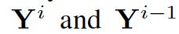
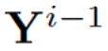
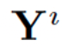
fastSVT - Subspace Recycling
Combine SVT and rSVD-BKI and recycle the calculated subspace.
Why rSVD-BKI instead of rSVD-PI?
When p large enough, rSVD-BKI attain higher accuracy than rSVD-PI
Consider
When i large, . Hence get closed.
We can use orthogonal basis of for when i large.

Slide 16
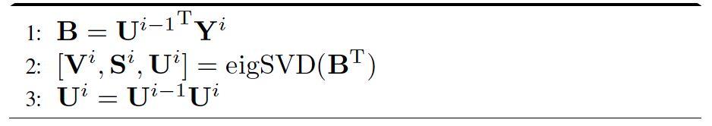
fastSVT - Subspace Recycling
Two proposed ideas
Reuse the orthogonal basis Q in the rSVD-BKI for Y(i−1), and then start from Step 8 in the rSVD-BKI algorithm for computing SVD of Y(i). (more accurate)
Reuse the left singular vectors U(i−1) in last iteration to calculate SVD of Y(i), with the following steps. (more costless)

Slide 17
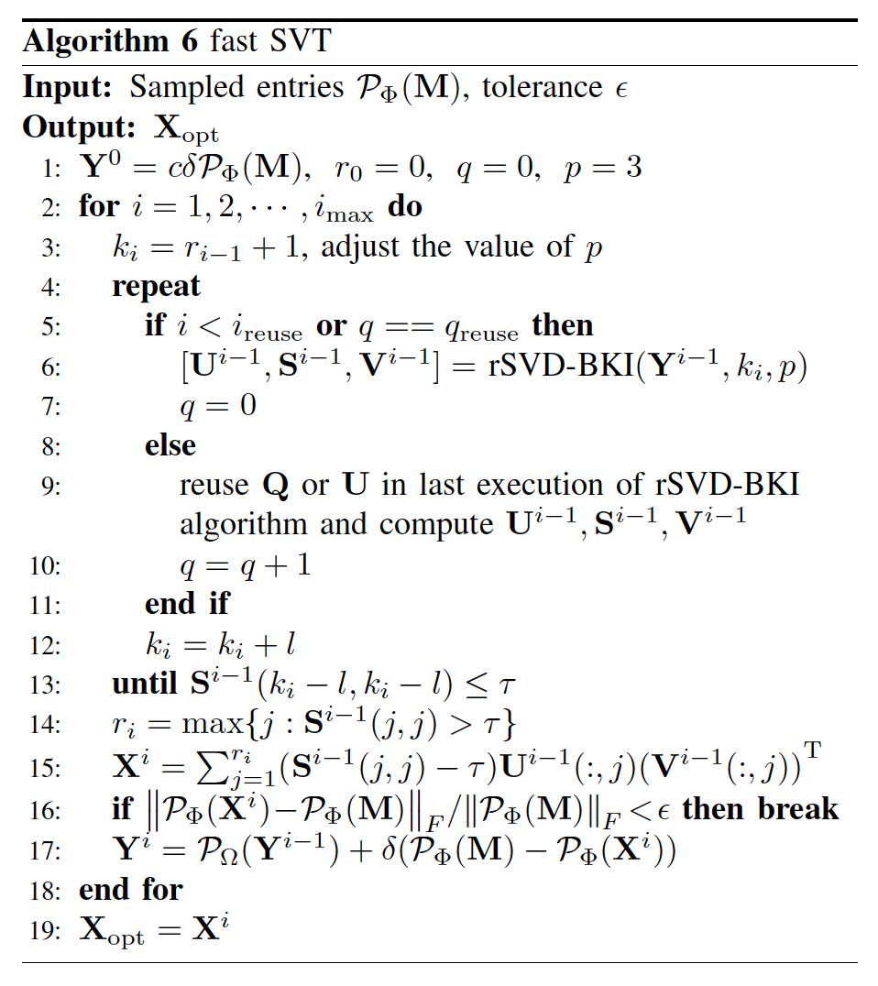



fastSVT - Recycle Q
= the minimum iteration to execute subspace recycling
= the maximum times of subspace recycling with one subspace

Slide 18



fastSVT - Recycle U
= the minimum iteration to execute subspace recycling
= the maximum times of subspace recycling with one subspace

Slide 19
EXPERIMENT

Slide 20
EXPERIMENTAL ENVIRONMENTS
Paper’s environemnt
CPU: Intel Xeon CPU @2.00 GHz
Memory: 128 GB RAM
Language: Matlab 2016a.

Slide 21

Validation of Fast rSVD Algorithms

Slide 22

Table explanation
p: power iteration parameter
t_{CPU} : Seconds of CPU running time
Error:
Sp. the speedup ratio to the basic rSVD

Slide 23

THE COMPARISON OF RSVD-PI AND RSVD-BKI ALGORITHMS

Slide 24

Image Inpainting

Slide 25

Image Inpainting

Slide 26
Results and Explanation
tw/o and tw/ denote the CPU time of our fast SVT Algorithm (Alg. 6) without and with subspace recycling respectively.
Sp1 and Sp2 are the ratios of tsvds and tlandsvd to the CPU time of our algorithm (with subspace recycling)
All algorithms present the same accuracy (same MAE value), with same iteration numbers (400 for Case 1 and 700 for Case 2).

Slide 27

Results for a smaller dataset

Slide 28

Results for a bigger dataset

Slide 29
Our Experiment
We run SVT and fastSVT_Q and fastSVT_U for the image provided in the paper and some other images
We record the picture for every 50 iterations

Slide 30
EXPERIMENTAL ENVIRONMENTS
Paper’s environemnt
CPU: Intel Xeon CPU @2.00 GHz
Memory: 128 GB RAM
Language: Matlab 2016a.
Our environment:
CPU: AMD Ryzen7 5800H @3.20 GHz
Memory: 32 GB RAM DDR 4 3200 GHz
Language: Matlab R2021a.

Slide 31

Our Experiment (image in the paper) original image using fSVT Reuse Q

Slide 32

i = 50

Slide 33
i = 100

Slide 34

i = 150

Slide 35

i = 192 (finish)

Slide 36

Time consumed for fSVT_Q

Slide 37
Our Experiment (image in the paper) original image using SVT

Slide 38

i = 50

Slide 39

i = 100

Slide 40

i = 150

Slide 41

i = 192 (finish)

Slide 42

Time consumed for SVT

Slide 43
Time Comparsion

Slide 44
Accuracy problem of fSVT Reuse U
However, we find that when we reuse U for fSVT, the algorithm didn’t terminate even i is over 300. Because of slow CPU and limited memory, we stopped the experiment.
We found that despite reusing U will converge faster at first, the error will increase after some iterations and then started to converge again, so if the minimum error is bigger than the tolerance we set, it will never terminate.
That is to say, if we only want the accuracy instead of speed, reuse Q is a better choice than reuse U.

Slide 45

Our Experiment (another image) original image using fSVT reuse Q

Slide 46

i = 50

Slide 47

i = 100

Slide 48

i = 150

Slide 49

i = 200

Slide 50

i = 250

Slide 51

i = 300

Slide 52

i = 350

Slide 53

i = 400

Slide 54

i = 413 (finish)

Slide 55




Smaller images
Succeed, i = 43
Failure, i = 80, matrix is nearly singular and spdiags function will fail

Slide 56
Thank you!

